Slide 1
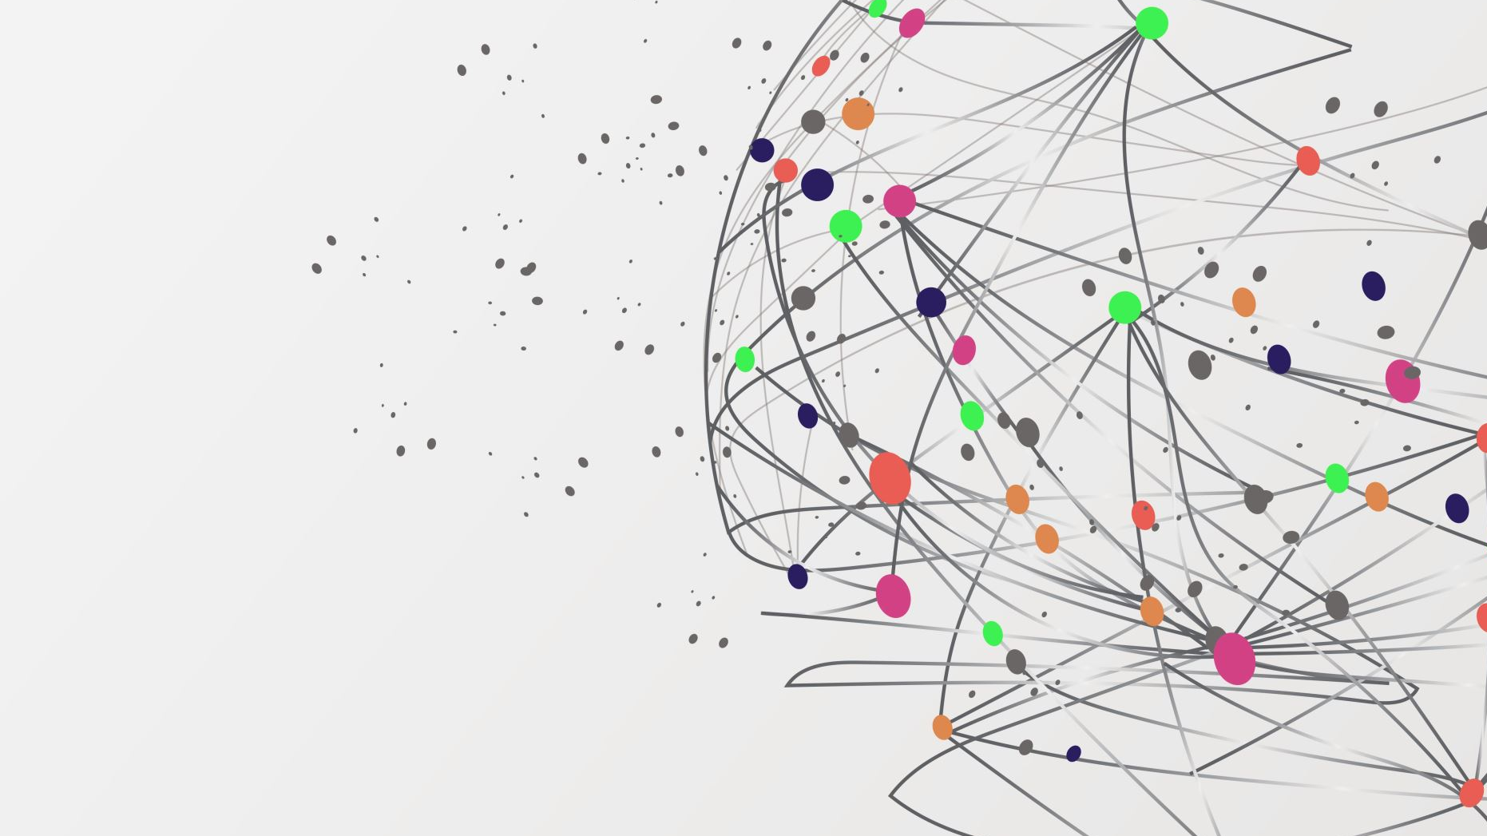
Spotify Dashboard
Visual Analytics
Marco Natale, Sahar Khanlari
A.Y. 2024/2025

Slide 2
Project Goals
Visualizing Spotify’s audio features
Discover meaningful patterns and trends in Spotify songs.
Enhance user understanding of song characteristics, genre and artist popularity, and temporal trends.

Slide 3
Data Structure
Dataset:
High popularity and low popularity Spotify songs
Audio Features:
Energy
Tempo
Danceability
Loudness
Liveness
Valence
Speechiness
Instrumentalness
Mode
Key
Acousticness

Slide 4
Data Processing Workflow
Preprocessing:
Removing duplicates, selecting audio features
Standardization
Dimensionality Reduction (PCA)
Clustering (K-Means)
Elbow method to identify optimal number of clusters

Slide 5
Visualizations
Scatterplot:
Displays clusters based on PCA components.
Interactive: Clicking filters related visualizations.
Bar Chart:
Shows average values of audio features (e.g., energy, danceability).
Dynamic updates with smooth transitions.
Date Interval Selector:
Slider to filter songs by release date.
Top 10 Genres, Artists, and Tracks:
Quick insights with filtering capabilities.
Dataset Overview Panel:
Key statistics like total songs, average energy, and more.

Slide 6
Key Insights
Cluster Characteristics: Differentiating upbeat tracks vs. mellow songs.
Trends: Popularity of genres like K-pop, artist trends.
Temporal Patterns: Bias toward recent releases.
Feature Correlations: Positive correlation between energy & loudness.

Slide 7
Related Works
Study | Objective | Clustering Technique | Reduction Method | Dataset Used
Our Approach | Visualize Spotify audio features to discover patterns | K-means | PCA | Spotify Dataset
Li (2024) | Enhance music recommendations using machine learning | K-means | PCA | Spotify Dataset
Wang & Haque (2017) | Cluster classical music based on acoustic features | Spectral Clustering | None | MusicNet Database (Classical Music)
Mukhopadhyay et al. (2024) | Compare content-based filtering with K-means for recommendations | K-means | PCA | Spotify Dataset

Slide 8
Thank you for your attention

